Slide 1


Security and Privacy 3.0 Introduction to Software Security
Dr. Laurent Gomez - OSCP certified
SAP Security Research
laurent.gomez@protonmail.com

Slide 2
Organisation

Slide 3
Lab Sessions
25% of the final mark for Software Security
15-22th of January
Java Security

Slide 4
Exam
The exam will consist of
●
Scenario/application description plus questions
Questions on a recent security article, a security architecture
●
Example:
Quantum cryptography (3 points)
The following article is an introduction to quantum cryptography:
« Information theory and cryptography convention take for granted that digital communications can always be spied or passively recorded for future use, even by someone who cannot understand its meaning. (One may note, however, important exceptions that consider the case where the eavesdropper is limited for technological reasons in its ability to spy on legitimate channels.) Saved encrypted communication can serve someone who hopes to discover the cryptographic key at a later stage, perhaps after accumulating enough ciphertext to facilitate cryptanalysis.
On the contrary, the Heisenberg’s uncertainty principle, which is at the heart of quantum physics, gave rise to cryptographic phenomena unachievable with conventional transmission devices. In particular, it allows the creation of a communication channel that no one can eavesdrop without risk of disturbing the transmission and being detectable by its legitimate users, even with the technology available to the spy. The result is a communication channel whose transmissions cannot be read or copied without knowing key information used for transmission. The spy is not even able to obtain partial information on the signal without altering it in ways that are unpredictable and uncontrollable. »
In this exercise, we make the following assumptions :
We have at our disposal a quantum cryptography channel for information transmission.
Such communication channel is a source of many errors. Therefore only little information can be exchanged.
Questions
What is the main security goal achieved with this secure channel? Explain. (0.5 point)
Assuming that you have at your disposal a quantum cryptography communication channel and a symmetric algorithm. What is the major issue solved by the use of quantum cryptography communication channel? (1 point)
Propose a cryptographic protocol for the establishment of a secure communication based on symmetric encryption. (1.5 point)

Slide 5
Final mark
Exam * 75% + JavaSecurityLabSession * 25%

Slide 6

Please register !!!
shorturl.at/cjmnp

Slide 7
References

Slide 8
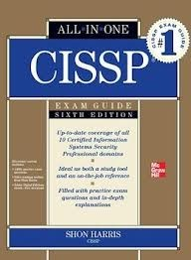
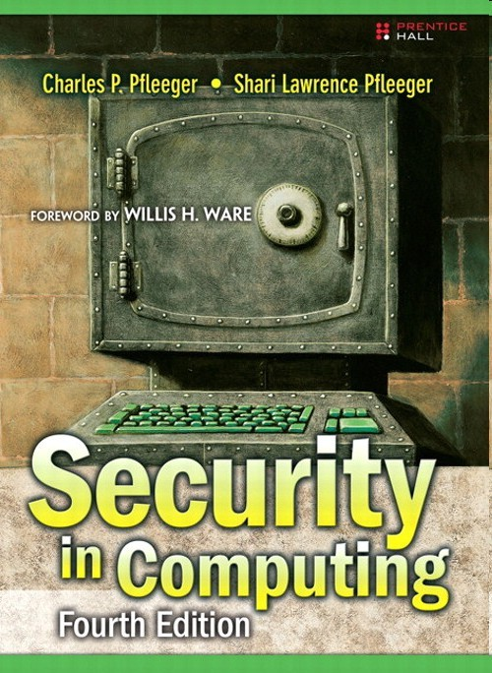
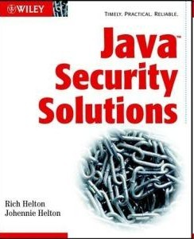
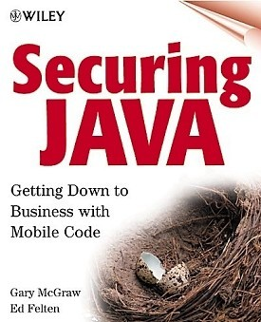

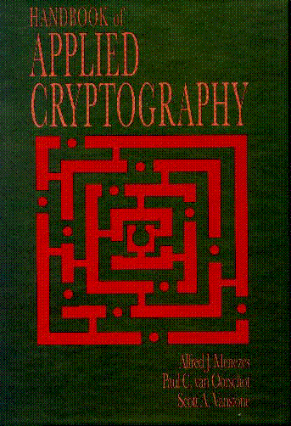

References

Slide 9
Why should we care about security ?
„I use urlencode() to encrypt my messages ...“

Slide 10

Principle of easiest penetration
“an intruder must be expected to use any available means of penetration. This is not necessarily the most obvious means, nor it is necessarily the one against which the most solid defense has been installed.”
Bad (buggy or hostile) programs
Bad (careless or hostile) people
giving instructions to good programs
Bad guy interfering with communications
Bad guy using social engineering
© 2016 SAP AG. All rights reserved.

Slide 11
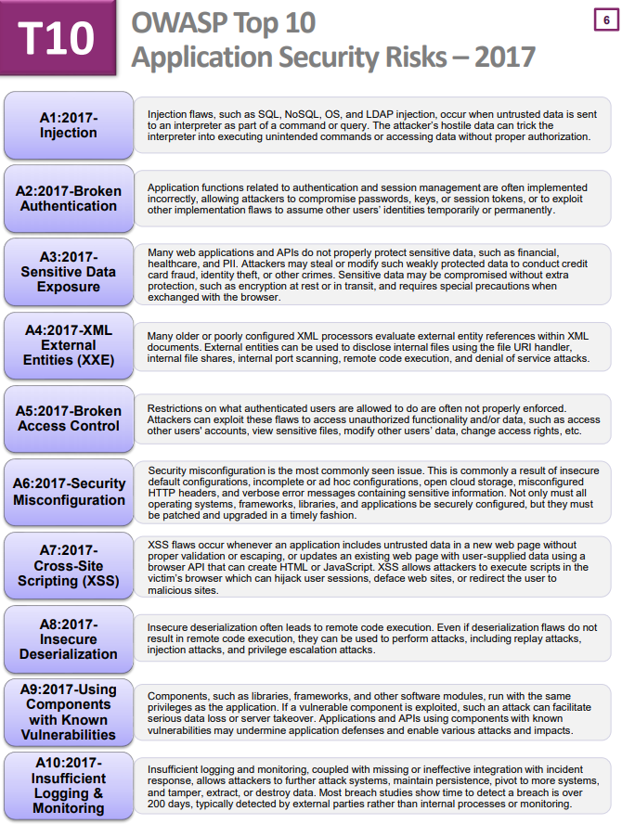
OWASP Top 10
Application vulnerability
© 2016 SAP AG. All rights reserved.

Slide 12
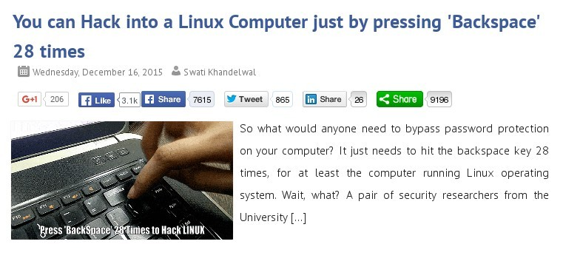
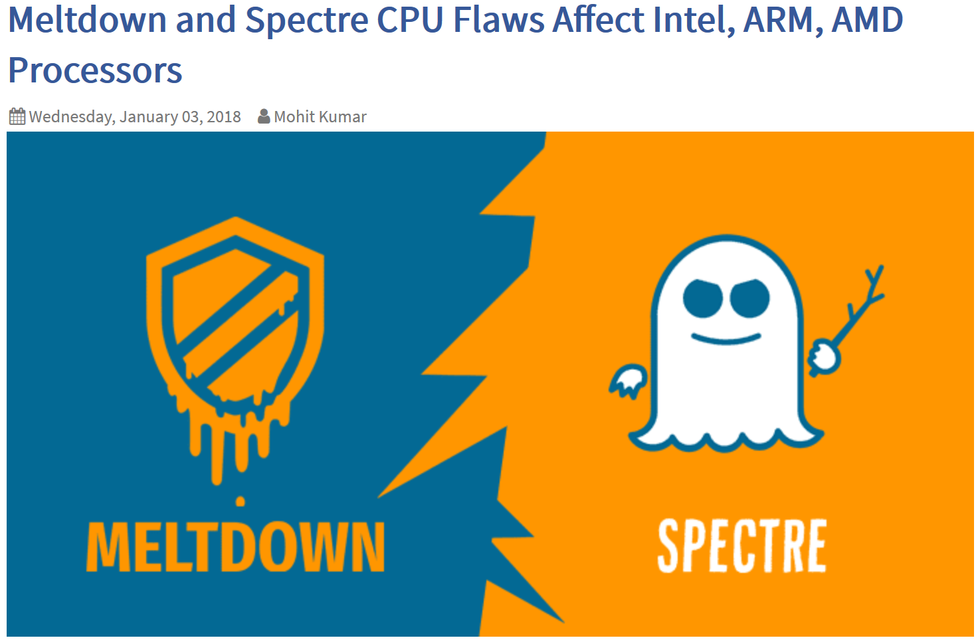
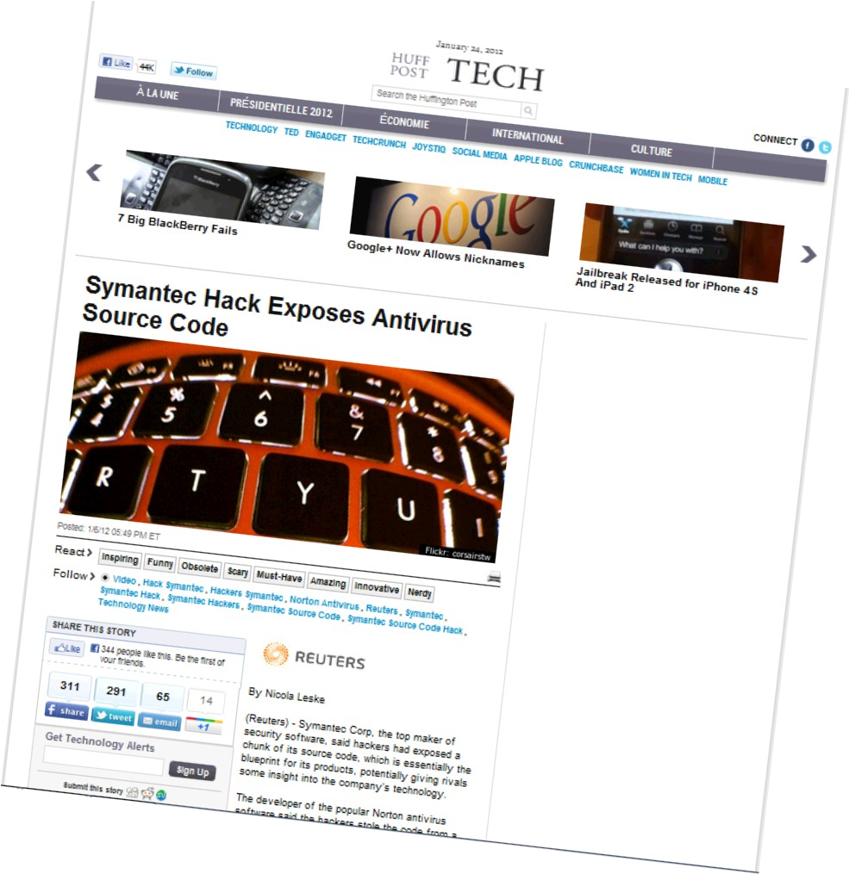
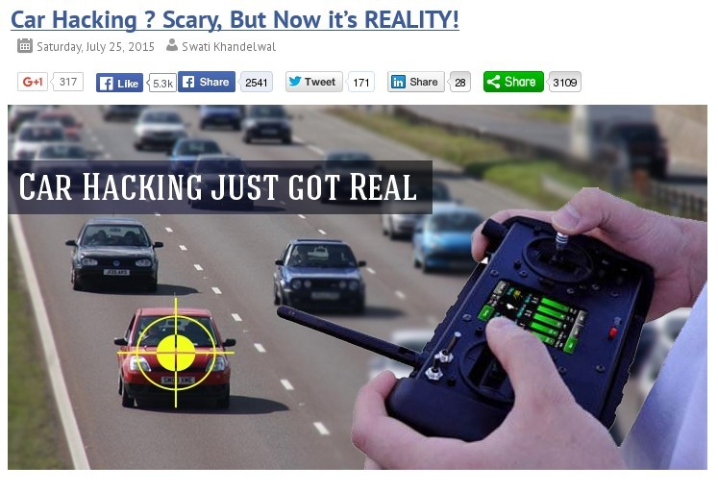
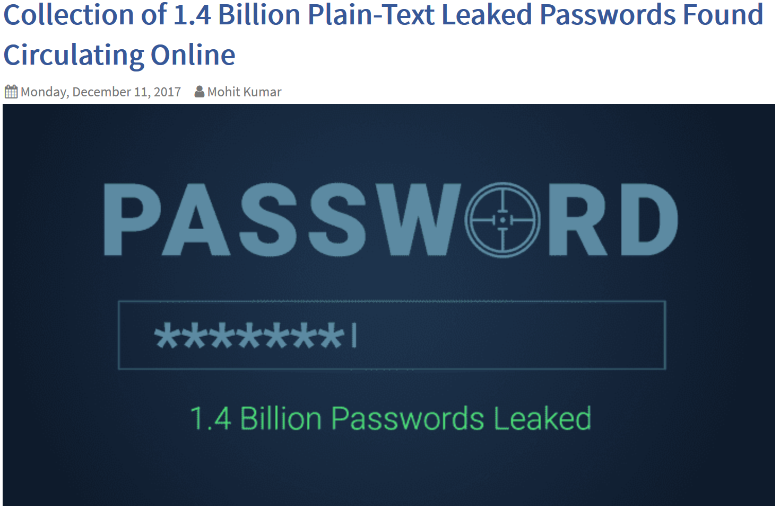
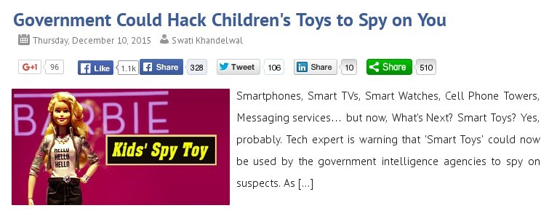
Example of attacks
http://thehackernews.com/
Social Engineering
Brute force cracking Rainbow table
Virus Trojan Phishing
Whale, spear
Cross side scripting Command injection Buffer overflow Race condition …
© 2016 SAP AG. All rights reserved.

Slide 13


Threat agents:
Who are the attackers?
Hackers/Crackers
White hat hackers
The “good guys”
Black hat hackers
Script kiddies Phreakers Carders Crackers
Hackivists
Ideological motivation to attack institutions system.
Industrial espionage
Airbus case
The Russian students case
Terrorism Police
Get access to criminals resources
National Intelligence Organization
Citizens Information Collection ECHELON, PRISM, …

Slide 14

Shellshock
CVE-2014-6271
GNU Bash through 4.3 processes trailing strings after function definitions in the values of environment variables, which allows remote attackers to execute arbitrary code via a
crafted environment, as ForceCommand feature in mod_cgid modules in the
demonstrated by vectors involving the OpenSSH sshd, the mod_cgi and
Apache HTTP Server, scripts executed
by unspecified DHCP clients, and other situations in which setting the environment occurs across a privilege boundary from Bash execution.
Quickly followed by
CVE-2014-6277, CVE-2014-6278, CVE-2014-7169, CVE-2014-7186, and CVE- 2014-7187
© 2016 SAP AG. All rights reserved.

Slide 15
How does ShellShock work?
Injection of OS command in env bash command
env command to be executed
Arbitrary command to be executed by Bash
env x=“() { :;};
echo vulnerable” /bin/bash
–c :
Legitimate command
© 2016 SAP AG. All rights reserved.

Slide 16
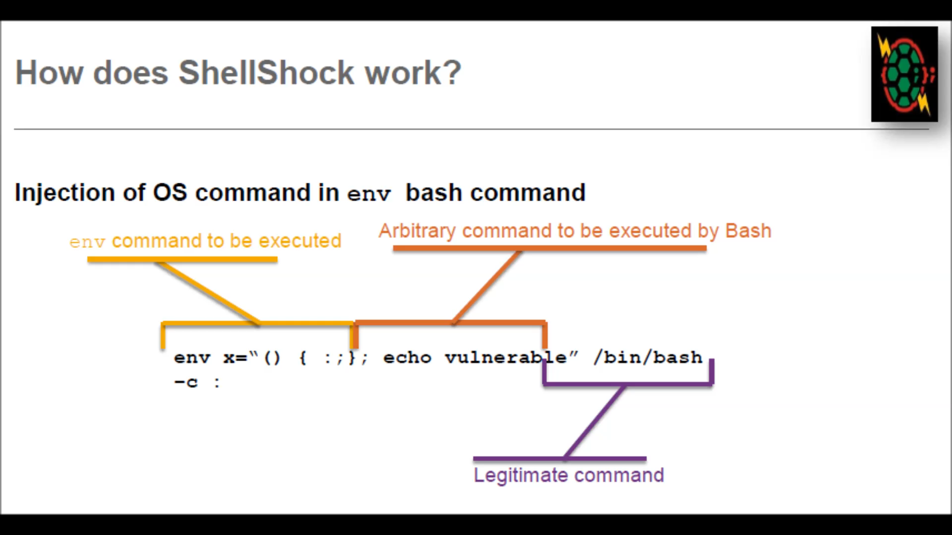
Shellshock
CVE-2014-6271
© 2016 SAP AG. All rights reserved.

Slide 17
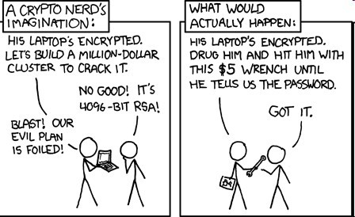
Security fundamentals
what does security really mean ?

Slide 18
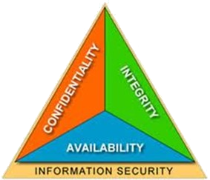
The CIA triad
Basic security goals
Confidentiality
“the assets of a computing system are accessible only by the authorized parties”
Prevent disclosure of information by unauthorized entities
Integrity
“assets can be modified only by the authorized parties or only in authorized way”
Prevent alteration of information by unauthorized entities
Availability
“assets are accessible to authorized parties”
Prevent disruption of access to information to authorised entities

Slide 19
Other security goals
Privacy
Equivalent to confidentiality
Non repudiation
Prevent false denial of involvement by either party in a transaction
Non-repudiation with proof of origin; which gives to the recipient of data the evidence that proves the origin of the data.
Non-repudiation with proof of receipt; which provides the originator of data with evidence that proves the data was received.

Slide 20
Computing systems assets
A computing organization is a collection of assets
Hardware (e.g., laptops, mobile phones) Software (e.g. HR system)
Storage media ( e.g., USB stick, database) Data and
Computing system
People
Media storage Data
Data
Removable storage
Software and Hardware
People
Computing security aims at protecting organizational computing systems from malicious manipulation and forbidden operations.
In this course, we focus on software, storage, and data protection.

Slide 21
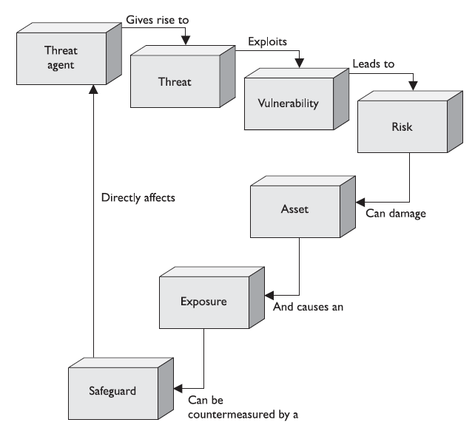
Definitions
A vulnerability is a lack of a countermeasure or a weakness in a countermeasure.
A service running, unlocked door, no visibility on access control policy
A threat is any potential danger that is associated with the exploitation of a vulnerability.
Default password of SQL server vulnerability exploited to gain access to employees data

Slide 22
Definitions
A risk is the likelihood of a threat agent exploiting a vulnerability and the corresponding business impact.
A control, or countermeasure, is put into place to mitigate (reduce) the potential risk.

Slide 23
Definitions
An exposure is an instance of being exposed to losses. A vulnerability exposes an organization to possible damages.
If password management is lax and password rules are not enforced or If a company does not have its wiring inspected and does not put proactive fire prevention steps into place.

Slide 24
Definitions
A control, or countermeasure, is put into place to mitigate (reduce) the potential risk. A countermeasure may be a software configuration, a hardware device, or a procedure that eliminates a vulnerability or that reduces the likelihood a threat agent will be able to exploit a vulnerability.
strong password management, firewalls, a security guard, access control mechanisms, encryption, security-awareness training.

Slide 25
Risk Management
Toward security policy definition

Slide 26
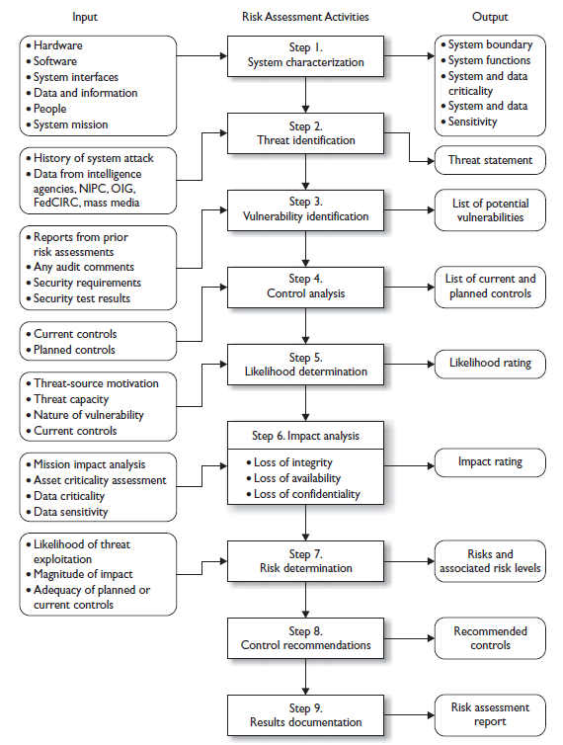
Risk assessment and analysis
Set a risk analysis team in charge of
❑
Identification of assets and their value to the organization.
Identification of vulnerabilities and threats.
Quantification the probability and business impact of these potential threats.
Provide an economic balance between the impact of the threat and the cost of the countermeasure, so called cost/benefit comparison
❑
❑
❑
NIST risk assessment methodology
© 2016 SAP AG. All rights reserved.

Slide 27

Risk assessment and analysis
Identification of vulnerability
Penetration test
A penetration test is a method of evaluating the security of a computer system or network by simulating an attack from a malicious source
The intent of a penetration test is to determine feasibility of an attack and the amount of business impact of a successful exploit, if discovered
Any security issues that are found will be presented to the system owner together with an assessment of their impact and often with a proposal for mitigation or a technical solution
Black box and white box approach
Threat modeling
Look a software component, and define set of possible attacks
© 2016 SAP AG. All rights reserved.

Slide 28
Risk assessment and analysis
Quantitative vs Qualitive Risk Analysis
Quantitative risk focus on measureable risks (monetary related)
Asset Value × Exposure Factor (EF) = Single Loss Expectancy (SLE)
The exposure factor (EF) represents the percentage of loss a realized threat could have on a certain asset,
SLE × Annualized Rate of Occurrence (ARO) = Annual Loss Expectancy (ALE)
The annualized rate of occurrence (ARO) is the value that represents the estimated frequency of a specific threat taking place within a 12-month timeframe.
Qualitative risk focus on subjective assessment of the risks
Assessment done by different actors within the company An overall scoring is done,
© 2016 SAP AG. All rights reserved.

Slide 29
Risk assessment analysis
Identify countermeasures and associated to cost
Selection of countermeasures
Evaluation of their effectiveness and functionality Total risk vs residual risk
Total risk = vulnerability * asset value Residual risk = total risk – countermeasures
Is it worth to buy a 3M€ firewall to protect a database with 3k€ information?
© 2016 SAP AG. All rights reserved.

Slide 30
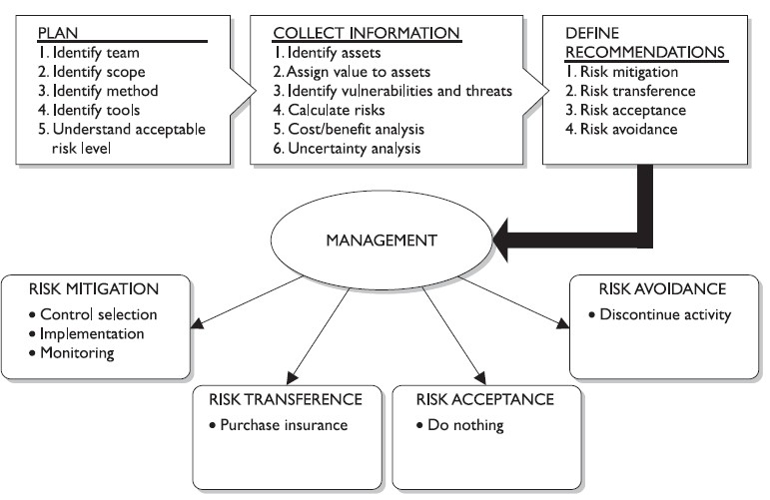
Risk assessment overall
© 2016 SAP AG. All rights reserved.

Slide 31
Security policy
Based on risk assessment
Security policy is a statement by the senior management which define what role plays in the organisation:
Driven by security governance (e.g., Personally Identified Information) Driven by security goals to be achieved (confidentiality of customer data) With the support of guidelines and procedures
Security policy is enforced through security controls.
Classification of information Access controls
Security awareness and education Certification and accreditation Audit
© 2016 SAP AG. All rights reserved.

Slide 32
Example of security policy
Keep everybody out
Isolation
Keep the bad guy out
Code signing, firewalls
Let him in, but keep him from doing damage
Sandboxing, access control
© 2016 SAP AG. All rights reserved.

Slide 33
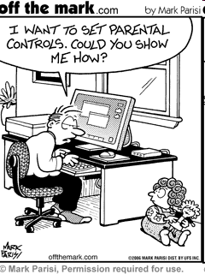
Security controls
How to implement security policy?

Slide 34
Four security controls categories
Physical controls e.g. fences, doors, locks and fire extinguishers;
Procedural controls e.g. incident response processes, management oversight, security awareness and training, disaster management;
Technical controls e.g. user authentication (login) and logical access controls, antivirus software, firewalls, encryption;
Legal and regulatory or compliance controls e.g. privacy laws, policies and clauses.

Slide 35
Technical controls
Access control and encryption
Access control
Data Classification
Identification, Authentication and Authorization
Cryptography
Data encryption
Signature
Cryptographic protocol for identification and authentication

Slide 36
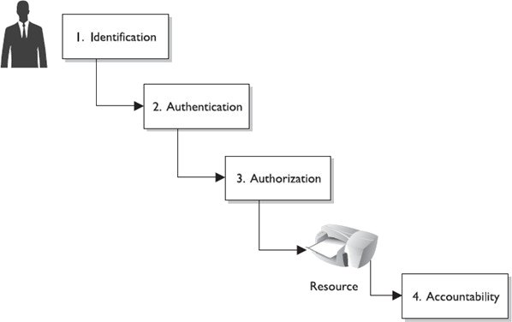
Access control
Identification, Authentication, Authorization
Identification
Subject supply identification information
Authentication
Verification of subject’s identification information
Authorization
Take access control decision based on subject authentication
Accountability
Audit log and monitoring to track subject activities on objects

Slide 37
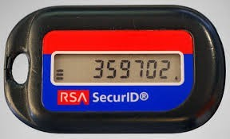
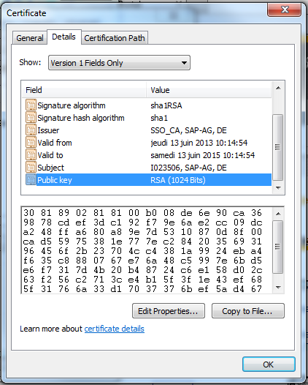

Access control
Authentication
Something you know
Password, passphrase
Something you have
Security token
One time password
Asynchronous
Synchronous
Certificate
Something you are
Biometry

Slide 38

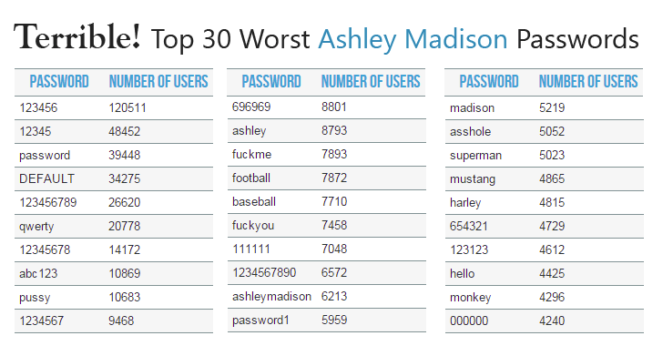
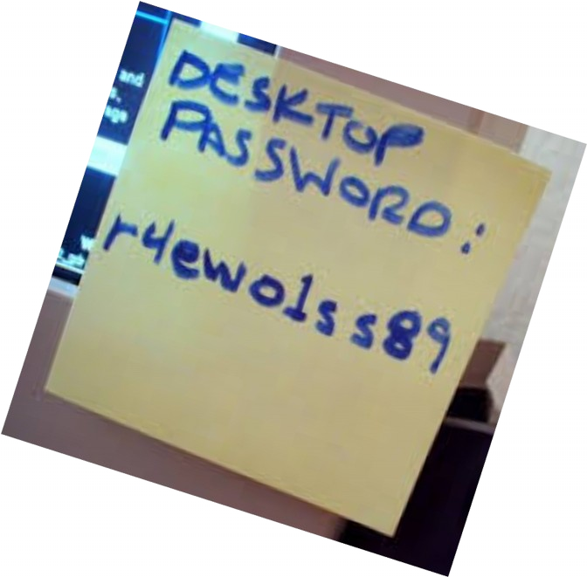
Access control
Password
“Pass-oire” authentication
Cheap but weak authentication mean. Lack of user education
Bad software development practices ….
Password management Password synchronization Self service password reset Assisted password reset

Slide 39
Access control
Authentication
One service, one Authentication Server Single sign on
allow to authenticate ONCE and get access to ALL resources
Bob authenticate himself to a Authentication Server (AS). Bob then delegate his authentication to services to the Authentication Server.
Examples of SSO
Kerberos, Sesame (extension of Kerberos with Public Key Infrastructure), Directory service (LDAP)

Slide 40
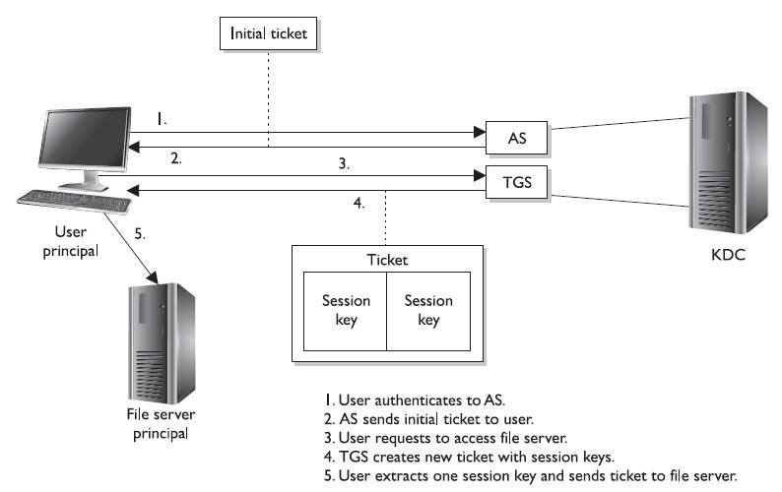
Kerberos
Example of Access control
Authentication Server
Ticket Granting Service
Key Distribution Center

Slide 41
Access control
Authorization
Default no access Access criteria
Roles, Group membership Physical, logical location Time
Need to know
Give access to only to required information
Least privilege
Give minimun access rights

Slide 42
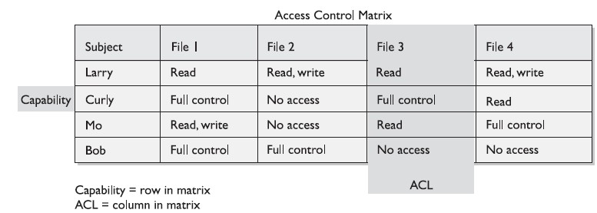
Access control
Authorization
Access control matrix
Capability list (subject oriented) Access control list (resource oriented)
Classification of data
Confidential, private, sensitive, public
Top secret, secret, confidential, sensitive but unclassified Unclassified

Slide 43
Effectiveness of security controls
Awareness of the problem
End user, administrator, software developer should agree on the need of security in computing system
Likelihood of use
Security should be easy-to-use security to be effective.
Overlapping control Periodic review

Slide 44

Cryptography as a toolbox

Slide 45
Cryptography terminology
Cryptography
Study of methods, mathematic technics related to security concept
Cryptosystem
Set of algorithm, key and secured protocol
Cryptanalysis
Study of existing cryptosystem

Slide 46
Cryptography Basic
Plain Text
trytore adthis messa

Slide 47
Cryptography Basic
trytore adthis messa
Cipher

Slide 48

Cryptography Basic
Key
trytore adthis messa
Cipher

Slide 49
Cryptography Basic
Key
Ciphered Text
trytore adthis messa
101101
010100
001111
101010
101010
Cipher

Slide 50

Cryptography Basic
trytore adthis messa
k
101101
010100
001111
101010
101010
k’
trytore adthis messa
Cipher
Decipher

Slide 51
Definition
Plain text
: An original text to be protected
Cipher
: the encryption mechanism
Decipher : the decryption mechanism
Key
: main tool for the encryption/decryption

Slide 52
Cryptographic primitives
Substitution Transposition

Slide 53
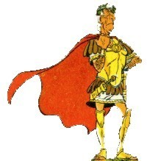




Substitution ciphering:
Mono-alphabetic substitution
Send me the recipe of the magical potion
Send me the recipe of the magical potion
Tfoe nf uif sfdjqf pguif nbhjdbm qpujpo
Tfoe nf uif sfdjqf pguif nbhjdbm qpujpo

Slide 54

Substitution ciphering : Mono-alphabetic substitution
Original Message
S | e | n | d
m
e
...
a
b
b
c
c
d
...
...
z
a
Encrypted Message
T | f | o | e
n
f
...

Slide 55
Substitution ciphering: Polyalphabetic substitution
Vigenere Ciphering
Based on the Caesar cryptosystem. A key is used to cipher the clear text
h | e | l | l | o |  | w | o | r | l | d
8 | 5 | 12 | 12 | 15 | 27 | 23 | 15 | 18 | 12 | 4
a | b | c | d
1 | 2 | 3 | 4
h+a | e+b | l+c | l+d | o+a | ' '+b | w+c | o+d | r+a | l+b | d+c
9 | 7 | 15 | 16 | 16 | 29 | 26 | 19 | 19 | 14 | 7

Slide 56
Substitution ciphering:
The ‘perfect’ substitution ciphering
The length of the key should be equal to the length of the message to be encrypted.
One-time pad
Difficult to distribute and store the key
Long random number sequences
Difficulty to synchronizate between the two parties

Slide 57
Transposition Columnar transposition
HELLO WORLD is encrypted as HORE LLWDLO
H | E | L | L
O |  | W | O
R | L | D

Slide 58
Transposition Columnar transposition
HELLO WORLD is encrypted as HORE LLWDLO
H | E | L | L
O |  | W | O
R | L | D

Slide 59
Ciphering mode
Stream Block

Slide 60
Stream ciphering
Stream ciphering is done bit per bit without waiting the whole encryption of the message.
Key generator
Message
 | Hello world!
ciphered bit
 | wdfesratrtde
substitution bit per bit
Example
XOR
One-time pad

Slide 61
Block ciphering
The plain text is divided into blocks.
A block cipher encrypts a group of plaintext symbols in one block
Key
hel lo wor ld!
Plaintext
Block cipher
Ciphered text
dfg tyu opt wer

Slide 62
Block ciphering
A strong cipher contains the right level of two main attributes: confusion and diffusion. Confusion is commonly carried out through substitution, while diffusion is carried out by using transposition. For a cipher to be considered strong, it must contain both of these attributes to ensure that reverse- engineering is basically impossible. The randomness of the key values and the complexity of the mathematical functions dictate the level of confusion and diffusion involved.

Slide 63
EBC Mode
Electronic Book Code Each block of 64 bits encode Prone to Replay Attack
HEL
LO
RLD
B1
B2
Bn
K
Cipher
K
Cipher
...
K
Cipher
C1
C2
Cn
WCS
TSF
GFS

Slide 64
CBC Mode
Cipher Block Chaining
Use the last encrypted block Need of a Initialization Vector
HEL
LO
WOR
IV
B1
B2
B3
K
Cipher
K
Cipher
K
Cipher
...
C1
C2
C3
AGF
GSF
GFS

Slide 65
Message.length mod Key.size !=0 ???
Pad with space
Input block: A B C D _ _ _ _ Hex : 41 42 43 44 20 20 20 20
Pad with zero
Input block: A B C D _ _ _ _ Hex : 41 42 43 44 00 00 00 00
Pad with zero expect the last one equals to the padding byte number
Input block: A B C D _ _ _ _ Hex : 41 42 43 44 00 00 00 04

Slide 66
Encryption algorithms
One way function Symmetric algorithm Asymmetric algorithm Hybrid algorithm

Slide 67
One-way function
Definition
A one-way function(OWF) is a function f such that for each x in the domain of f,
it is easy to compute f(x)
but for essentially all y in the range of f, it is computationally infeasible to find any x such that y = f(x).
Anti collusion property: x has a single representation f(x).
Example
Hash function Random sequences
Easy
x
f(x)
Difficult

Slide 68
One-way function: Hash function
A hash function is any function that can be used to map data of arbitrary size to data of fixed size.
Properties
∀ m∈ M , H (m) = n
For each m, n is unique.
From n is not possible to find m.
H easy to compute
n is called DIGEST

Slide 69
Symmetric algorithm
Encryption: Decryption: Property:
E: MxK → C;
E(m, k)=c
D: CxK → M; D(c, k)=m
D( E(m, k), k)=m
k
k
trytore adthis messa
101101
010100
001111
101010
101010
trytore adthis messa
E(M, K)=M’
D(M’, K)=M

Slide 70

Symmetric key
The same key is used for the encryption and decryption
Each part should be aware of the key.

Slide 71
Symmetric algorithms
Algorithm | Block size(bits) | Key size(bits)
BlowFish | 64 | 32 or 448
Lucifer - DES (1974) | 64 | 64 bits 56 bits payload – 8 bits parity
3DES | 64 | 128 – 192
IDEA | 64 | 128
RC2/5/6 | 64 | 1-1024 64 usually
Rjindael -AES (1997) | 128 | 128,192,256

Slide 72



3DES encryption
DES-EDE3
trytore adthis messa
000011
001010
101010
101001
101010
DES
Ciphering
101010
101010
101101
010010
010101
DES
Deciphering
010101
010101
010101
010001
010100
DES
Ciphering

Slide 73

3DES encryption
DES-EDE3
trytore adthis messa
000011
001010
101010
101001
101010
DES
Deciphering
101010
101010
101101
010010
010101
DES
Ciphering
010101
010101
010101
010001
010100
DES
Deciphering

Slide 74

Asymmetric algorithm
Encryption
E: MxK→ C;
E(m, k1)=c
Decryption D: CxK→ M;
D(c, k2)=m
Property
D( E(m, k1), k2)=m
k1
k2
trytore adthis messa
101101
010100
001111
101010
101010
trytore adthis messa
Cipher
Decipher

Slide 75
Asymmetric algorithm
K1 and K2 are respectively
Private key Public key
The private key is not distributed
Keep it secret
Used to decrypt message encrypted with public key.
Public key is distributed
The public has to be distributed
Used to decrypt message encrypted with the private key

Slide 76
Public key encryption
Confidentiality
Public key
Private key
trytore adthis messa
101101
010100
001111
101010
101010
trytore adthis messa
Cipher
Decipher

Slide 77
Private key encryption
Private key
Public key
trytore adthis messa
101101
010100
001111
101010
101010
trytore adthis messa
Cipher
Decipher
Non Repudiation of origin Authentication

Slide 78
Asymmetric algorithms
ElGamal Diffie Hellman RSA
DSA
McEliece Merkle-Hellman Chor-Rivest
Goldwasser-Micali Blum-Goldwasser

Slide 79
Comparison between symmetric and asymmetric algorithms
Symmetric cipher for confidentiality
+ Good performances
Key delivery problems
Asymmetric cipher for confidentiality, integrity and authentication
Poor performances
+ No key delivery problems

Slide 80
Hybrid ciphering
Let’s combine symmetric and asymmetric algorithms for secure communications
Asymmetric cipher for session key exchange Secret key for fast message encryption/decryption

Slide 81






Hybrid cipher – scenario (1/5)
???
Symmetric key
Alice
SessionKey
Bob
SessionKey
Man in the Middle

Slide 82





Hybrid cipher – scenario (2/5)
Bob Public Key
Alice
SessionKey
Bob
{
, }
public, private
Bob Public Key
Man in the Middle

Slide 83



Hybrid cipher – scenario (3/5)
Encrypt
(
)
SessionKey
Bob Public Key
Alice
SessionKey
Bob
{
, }
public, private
Man in the Middle

Slide 84




Hybrid cipher – scenario (4/5)
Decrypt
[ Encrypt
(
) ]
SK
BPrivateK
BPublicK
Alice
SessionKey
Bob
{
, }
public, private
Man in the Middle

Slide 85
Hybrid cipher – scenario (5/5)
Decrypt
( aMessage )
SessionKey
Encrypt
( aMessage )
SessionKey
Alice
SessionKey
Bob
SessionKey
Man in the Middle

Slide 86
Use of cryptography for security controls

Slide 87
Use of cryptography for digital signature
A digital signature of a message is a number dependent on some secret known only to the signer, and, on the content of the message being signed
Security goals
Message integrity
Non repudiation of origin of the message
Digital signature schemes is composed of
Signature processing Verification processing

Slide 88

Signature process: Document hashing
S:MxK1 →C
S(m, k1)=c
Contract
Signature
...........
............
......................
.......................
2.Cipher | 10111011101001101101
1.Hash
10101010101001101101
Contract ........... ............ ...................... .......................
 | 101110 111010 011011 01
3
3

Slide 89

Signature process: Asymmetric encryption
Private key
Contract
2.Cipher | 10111011101001101101
...........
............
......................
.......................
Signature
1.Hash
10101010101001101101
Contract ........... ............ ...................... .......................
 | 101110 111010 011011 01
3
3

Slide 90
Signature process
Contract
2.Cipher | 10111011101001101101
...........
............
......................
.......................
Signature
1.Hash
10101010101001101101
Contract ........... ............ ...................... .......................
 | 101110 111010 011011 01
3
3

Slide 91

Signature verification process: Document hashing
Contract
101110
111010
011011
01
...........
............
......................
.......................
Contract
...........
............
......................
.......................
Signature
5. Hash
5. Decipher the signature
Contract hashed
6. ?=
Contract hashed

Slide 92
Signature verification process:
Contract
101110
111010
011011
01
...........
............
......................
.......................
Contract
...........
............
......................
.......................
Signature
5. Hash
5. Decipher the signature
Contract hashed
6. ?=
Contract hashed

Slide 93
Signature verification process:
Contract
101110
111010
011011
01
...........
............
......................
.......................
Contract
...........
............
......................
.......................
Signature
5. Hash
5. Decipher the signature
Contract hashed
6. ?=
Contract hashed

Slide 94

Certificate authentication
Definition
Certificate are based on asymmetric cryptographic primitives
Certificate
Public Key
Private Key

Slide 95
Java Security

Slide 96
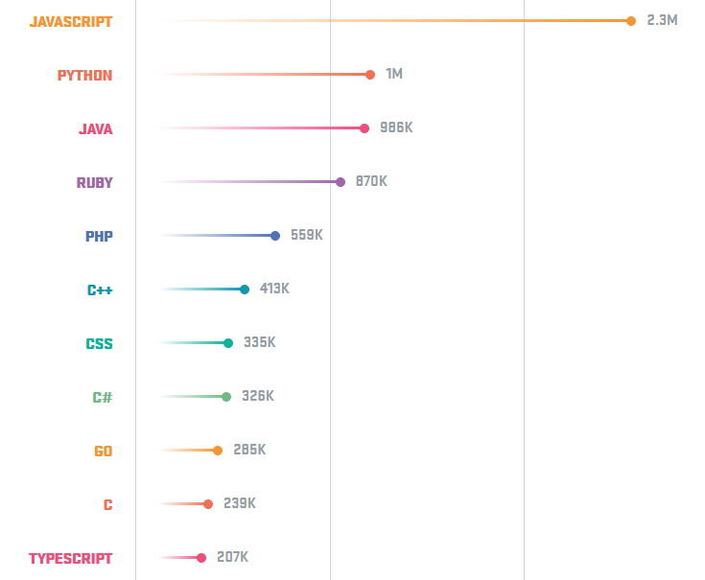
Top 10 Programming Language Popularity of Programming Languages on GitHub.

Slide 97
Why Java Security ?
Java provides basic library to get access to local resources
File system Network access
Peripheral access (display, keyboard, mouse, sound) System properties and facilities access (Memory, clock, ...)

Slide 98
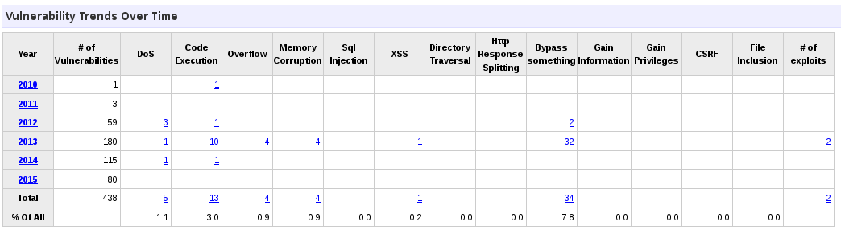
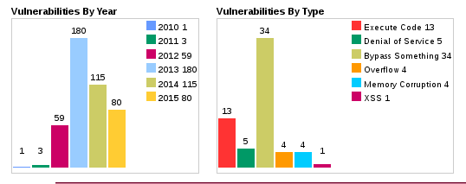
Vulnerable JRE

Slide 99
Java language security
Object-oriented
Access control via Public/Protected/Private/Final
Strongly typed
Object casting is restricted
Garbage collection
Free memory when it is no longer needed
No pointer
Memory access is restricted to the declared class instances.
Exception handling
Array bounds are checked for all array accesses
Misc
Object can’t be used before they are initialized.
Multi-threaded

Slide 100
The sandbox
idea: limit the resources that can be accessed by applets
JVM
local code remote code
(applets)
sandbox
resources
introduced in Java 1.0
local code had unrestricted access to resources downloaded code (applet) was restricted to the sandbox
•
•
•
cannot access the local file system cannot access system resources,
can establish a network connection only with its originating web server

Slide 101
The concept of trusted code
idea: applets that originate from a trusted source could be trusted
JVM
local code
signed and trusted
sandbox
remote code
(applets)
unsigned, or signed and
untrusted
resources
introduced in Java 1.1
applets could be digitally signed
unsigned applets and applets signed by an untrusted principal were restricted to the sandbox local applications and applets signed by a trusted principal had unrestricted access to resources

Slide 102
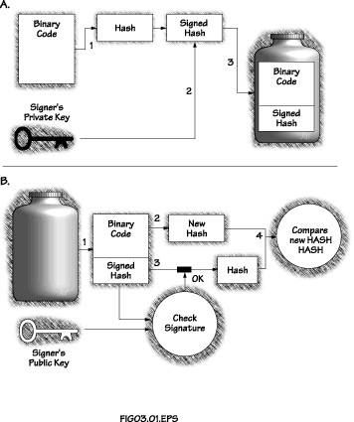
Signed java code

Slide 103
Un-trusted java code can’t
Input/Ouput restriction Read/write/delete/Rename file on the client file system Create/list a directory
Check if a file exists
Obtain information on a file/directory
Network restriction
Create a network connection
Listen and accept any network connection
Create top-level windows without an untrusted window banner
System restriction
Obtain user’s username or home directory name through any means,including trying to read the system properties: user.name, user.home, etc
Define any system properties
Run any program through Runtime.exec()
Make the Java interpreter exists, using either System.exit() or Runtime.exit()
Load dynamic library using load() or LoadLibrary()
Specify any network control functions

Slide 104
Un-trusted java code can’t
Thread restriction
Create or manipulate threads
JVM restriction
Create a ClassLoader
Create a SecurityManager
Define classes which are part of packages on the client system

Slide 105
Fine grained access control
idea: every code (remote or local) has access to the system resources based on what is defined in a
policy file
JVM
local or remote code
(signed or unsigned)
class loaders
policy file
resources
introduced in Java 2
a protection domain is an association of a code source and the permissions granted the code source consists of a URL and an optional signature
permissions granted to a code source are specified in the policy file
grant CodeBase “http://java.sun.com”, SignedBy “Sun” {
© 2011 SAP AG. All rights reserved.
e

Slide 106
Sample permissions
File access
java.io.FilePermission “/tmp/*”, “read,write” java.io.FilePermission “${user.home}${/}*”, “read”
System permissions
java.lang.RuntimePermission “getClassLoader”, “”;
AWT permissions
java.awt.AWTPermission “accessEventQueue”, “”;
Network access
java.io.SocketPermission “*:1024-”, “connect” java.io.SocketPermission “*:8080”, “accept,listen”

Slide 107
Policy
Grant a set of permissions to classes based on
Source (URL) Signer(s)
grant codeBase “http://polytech/java”{ … }{
permission java.io.FilePermission “<<ALL_FILES>>”, “read”; };

Slide 108
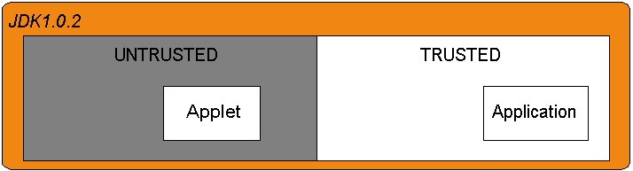
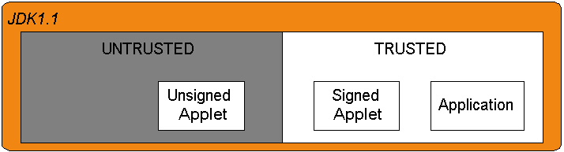
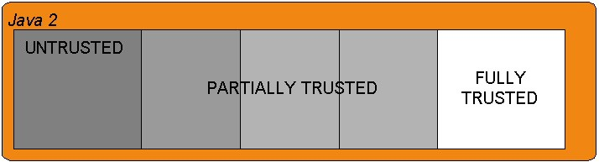
Java Security Model History

Slide 109
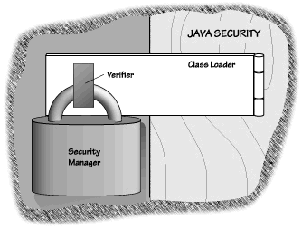
Java Security Model

Slide 110
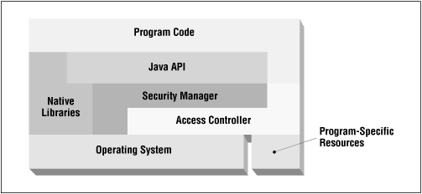
Java Security at run-time

Slide 111
SecurityManager
The security manager is the security policy enforcement point
Check methods called by system
“checkRead(String filename)” Method throws exception if invalid
checkExec
checkRead
checkWrite
checkListen
checkConnect
checkCreateClassLoader

Slide 112
Access controller
The AccessController class is meant for two purposes,
Checks access to system resources
Based on current security policy
Implements stack inspection algorithm
Marks code as privileged

Slide 113
Java Security Tools
© 2016 SAP AG. All rights reserved.

Slide 114
Jarsigner
Sign a jar file with a owner private key.
Class Owner Certificate
Use of
Class
Jar
Jar
Jar signature
SignedJar
VerifySignature

Slide 115
Jarsigner
jarsigner [options] jar-file alias
-keystore <url> keystore file location
-storepass <password>
-keypass <password>
password for keystore integrity password for private key (if different)
-sigfile <file>
-signedjar <file>
-verify
-verbose
-certs display
-internalsf
-sectionsonly
name of .SF/.DSA file
name of signed JAR file verify a signed JAR file
verbose output when signing/verifying certificates when verbose and verifying
include .SF file inside signature block don't compute hash of entire manifest

Slide 116
Jarsigner
jarsigner
-keystore myKeyStore
-storepass desstelecom
-signedjar mySignedJar.jar myJar.jar laurent.gomez

Slide 117
Java keystore
Alias
represented as
Keytool
KeyStore
set of
Certificat
command-line
Options :
tool
for keystore
management
-genkey : generates a pair of keys
-alias : binds an alias to an entry of the keystore
-keyalg : specifies which algorithm to use
-keysize : specifies the length of the key
-keypass : specifies the passphrase
-validity : validity date of the store
Exemple:
keytool -genkey -alias laurent -keyalg RSA
-keysize 1024 -keypass totofaitduvelo

Slide 118
Java Security API

Slide 119
Cryptography APIs and Security Mechanisms
Java Security API’s (JCA/JCE) provides security mechanisms for
Encryption/Decryption Digital signature Hash function
Java Security provides a set of security mechanisms For secure communication (JSSE)
For authorization management (JAAS)
© 2016 SAP AG. All rights reserved.

Slide 120
Data Integrity and Confidentiality in Java : JCA/JCE Java APIs
Because of US restrictions on the exportation of crypto products, there are two parts to the library:
JCA (Java Cryptography Architecture)
Basic concepts, design patterns, extensible architecture for basic concepts and one basic provider (SUN)
Certificate and digital signature JCE (Java Cryptography Extension)
A JCA extension with a ‘ strong ’ crypto provider. JCA again comes in two parts: API et SPI
Encryption, key generation and hash functions
SPI (Service Provider Interface) for implementing providers

Slide 121
Security Provider
A security provider is an implementation of a set of security mechanisms compliant with the JCA and JCE APIs
ORACLE provides a security provider used by default Existing provider
IAIK specification
http://jce.iaik.tugraz.at/products/01_jce/features/algorithms/index.php
Bouncycastle specification
http://www.bouncycastle.org/specifications.html
Cryptix specification
http://www.cryptix.org/products/jce/index.html
© 2016 SAP AG. All rights reserved.

Slide 122
Import a security provider
import org.bouncycastle.jce.provider.*;
...
Provider prov = new org.bouncycastle.jce.provider.BouncyCastleProvider();
Security.addProvider(prov);
© 2016 SAP AG. All rights reserved.

Slide 123
Create a Cipher Engine
// get a cipher instance with the default provider
Cipher aCipherInstance = Cipher.getInstance(“<AlgorithName>”);
// get a DES cipher instance with the bouncycastle
Cipher aCipherInstance = Cipher.getInstance(“<AlgorithmName>”, new BouncyCastleProvider()));

Slide 124
Generate a symetric key
// Generates a secret key
KeyGenerator kg = KeyGenerator.getInstance
("<AlgoritmName>");
SecretKey sk = kg.generateKey ();

Slide 125
Generate a asymetric key pair
Algorithme
Provider
KeyPairGenerator kpg;
kpg = KeyPairGenerator.getInstance
(‘‘RSA’’,
‘‘SUN’’);
KeyPair kp = kpg.getKeyPair ();
PublicKey pk = kp.getPublic(); byte[] theKey = pk.getEncoded ();
System.out.println (‘‘The public key is ’’+theKey);

Slide 126
Encrypt data
// Creates the Cipher
Cipher c = Cipher.getInstance("DES");
// Initialises the cipher with the key ‘ k ’
c.init(Cipher.ENCRYPT_MODE, k);
// This byte array contains the original byte[] message = {...}
message
// Encrypts the message
byte[] encryptedMessage = c.doFinal (message);

Slide 127
Decrypt data
// Creates the Cipher
Cipher c = Cipher.getInstance("DES");
// Initialises the cipher with the key c.init(Cipher.DECRYPT_MODE, k);
// This byte array contains the encrypted
message
byte[] encryptedMessage = ...
// cipher the message
byte[] clearTextMessage = c.doFinal (encryptedMessage);

Slide 128
Key management
KeyStore
Problem: how do we store a key on the disk ?
Method getEncoded of class Key produces a byte[]
Classes KeyFactory and SecretKeyFactory pour the reverse operation
class java.security.KeyStore
Can be stored or read from the disk with methods store and load, protected with a password
Method setKeyEntry (String alias, PrivateKey key, String passphrase, Certificate[] chain)
Method getPrivateKey (String alias, String passphrase)
Method setCertificateEntry (String alias, Certificate cert)

Slide 129
Conclusion
Security threats and countermeasures
Understand security threats, vulnerabilities, and risk assessment on software security.
Cryptography as a tool for software security
Cryptography is a tool box for software security
• Security mechanisms massively based on cryptography
Have a basic understanding of cryptographic mechanisms in order to use them in your applications.
Java security
Understand Java Security Model, and its configuration Being able to encrypt/decrypt, sign data within Java

